Slide 1

Course:
Software Engineering
Presentation on :
Extreme Programming(XP)

Slide 2
Submitted by
Swapnil Saha
ID:IT-21028
3rd year 2nd semester
Submitted To
Mr. Ziaur Rahman
Assistant Professor
Dept. of ICT
Mawlana Bhashani Science and Technology University

Slide 3
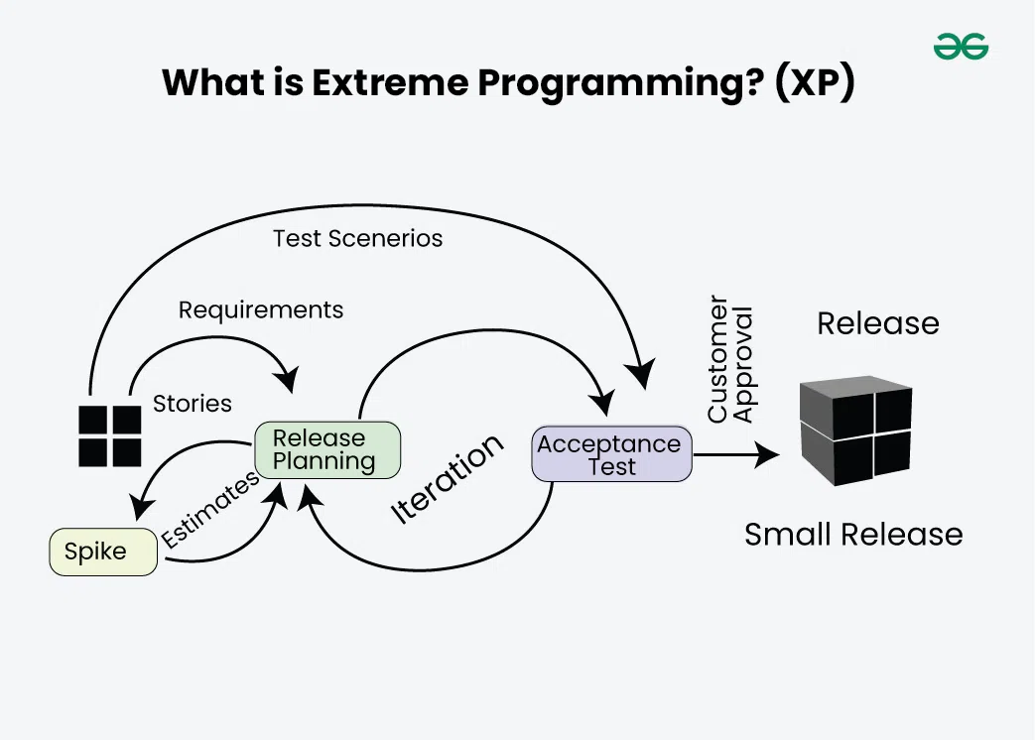
What is Extreme PROGRAMMING?
Extreme Programming(XP) is an agile software development methodology which was designed for improving the software quality and responsiveness to customer needs. It has some unique abilities like simplicity , continuous feedback , frequent delivery , teamwork etc.

Slide 4
XP! WHAT IS THAT ?
“XP is a light weight methodology for small to medium sized teams developing software in the face of vague or rapidly changing requirements” - Kent Beck
What is XP?
Lightweight
Humanistic
Discipline
Software Development
XP’s values and principles :
Communication -> pair programming, user stories, customer involvement
Simplicity -> Look for the simple things
Feedback -> Developers always needs immediate feedback which help them for improve in the code
Courage -> To fix the problem faithfully

Slide 5
XP’s PRACTICES
1. Incremental Planning :
Select user stories for this release
Break stories into tasks
Plan Release
Evaluate System and iteration
Release Software
Develop , integrate , test
2. Small Releases : Delivering software in small , rapid feedback.
Work update
Developer
Customer
Rapid feedback

Slide 6
XP’s PRACTICES
3. Simple Design :
Enough to meet the requirements
No duplicated functionality
Fewest possible classes and methods
4. Test-Driven Development (TDD): Writing tests before actual code.

Slide 7
XP’s PRACTICES
5. Refactoring : Improving code without changing its behavior. It basically means that we have to restore or fixup the code without changing anything. It just set up the unorganized code into a organized one.

Slide 8
XP’s PRACTICES
6. Pair Programming : It means that all production code is written with two people looking at one machine. They're working with one keyboard and one mouse or they're not just interfering and writing on each other's code. And the way in which that happens is by playing different roles at different times. So the two developers alternate between the role of programming and strategizing , where strategizing means, for example, looking at the code that has been written and thinking whether that would work. And interestingly, there are measurements, there are studies that suggest that development productivity with pair programming is similar to that of two people working independently. one of the main objections against pair programming, which is why should I put two developers together, which is going to cut their productivity in half. It is not. Studies shows that that does not happen. And that the resulting code can actually benefit from the fact that two developers are working together.

Slide 9
XP’s PRACTICES
7. Continuous Integration:
It means that frequent code integration into the repository.
Programming
Local Tests
System Tests
Integrate

Slide 10
Benefits of XP
Improved Code Quality
Faster Adaptation to Changes
Enhanced Collaboration
Customer Satisfaction
Reduced Project Risks
Continuous Improvement
Increased Developer Productivity
Better Team Morale

Slide 11
Challenges in Extreme Programming (XP)
High Communication Demands
Requires Strong Team Discipline
Intense Customer Involvement
Not Applicable for all Teams
Time-Consuming Practices
Testing can be Significantly Overhead
High Cost in Training and Transition

Slide 12
Thank You

